Slide 1
Getting Started with Windows on the Intel Galileo
Bret Stateham
Microsoft Technical Evangelist
bretstateham.com
@BretStateham

Slide 2
Overview
Windows Developer Program for IoT
Installing Windows on Galileo
Running Code
In Windows
Next Steps

Slide 3

Get the files…
The source files of the slides and demos for my entire IoT series here: http://aka.ms/IoTSource
Or download a .zip with the latest files: http://aka.ms/IoTZip
Finally, watch my IoT videos here: http://aka.ms/IoTVids

Slide 4
Windows Developer Program for IoT

Slide 5
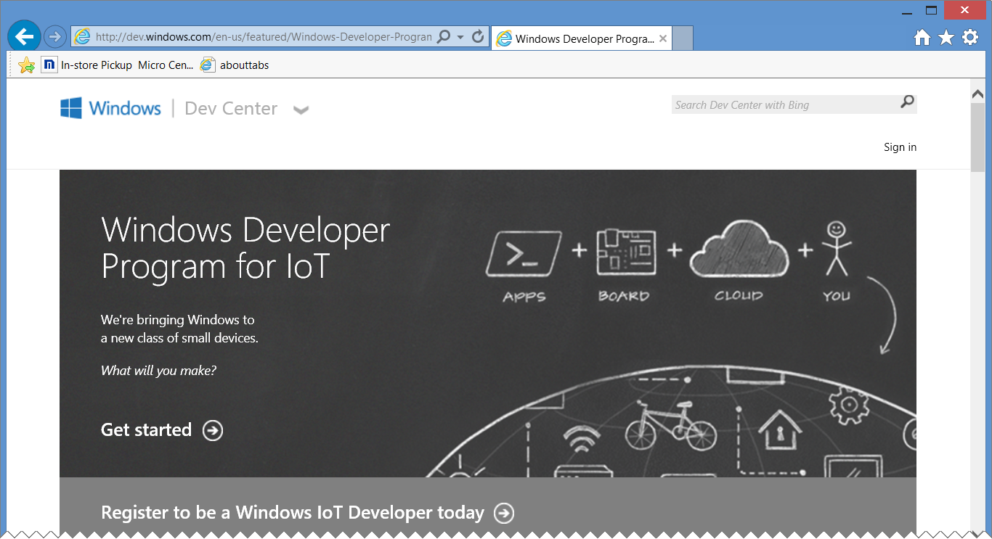
Windowsondevices.com
http://windowsondevices.com/

Slide 6
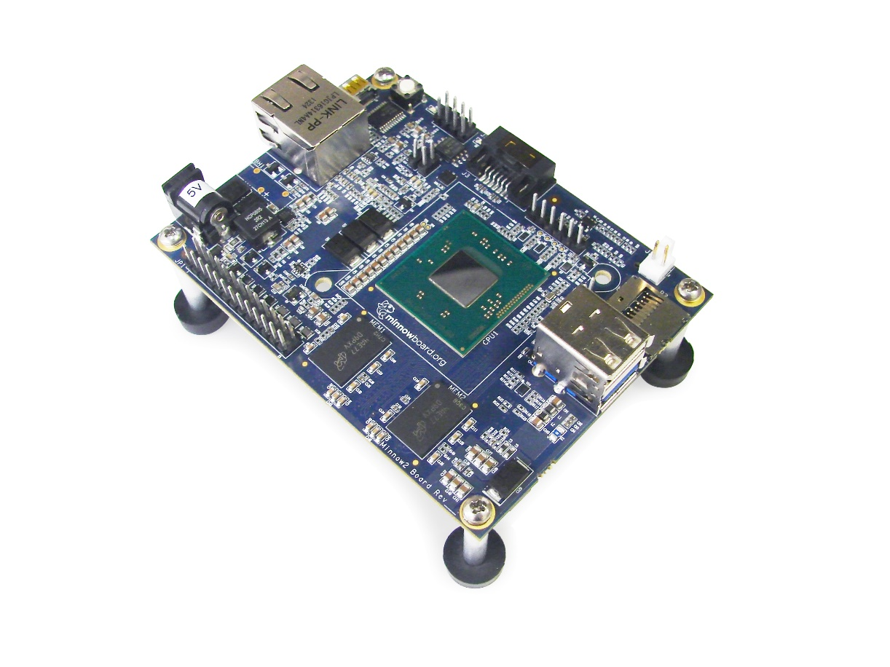
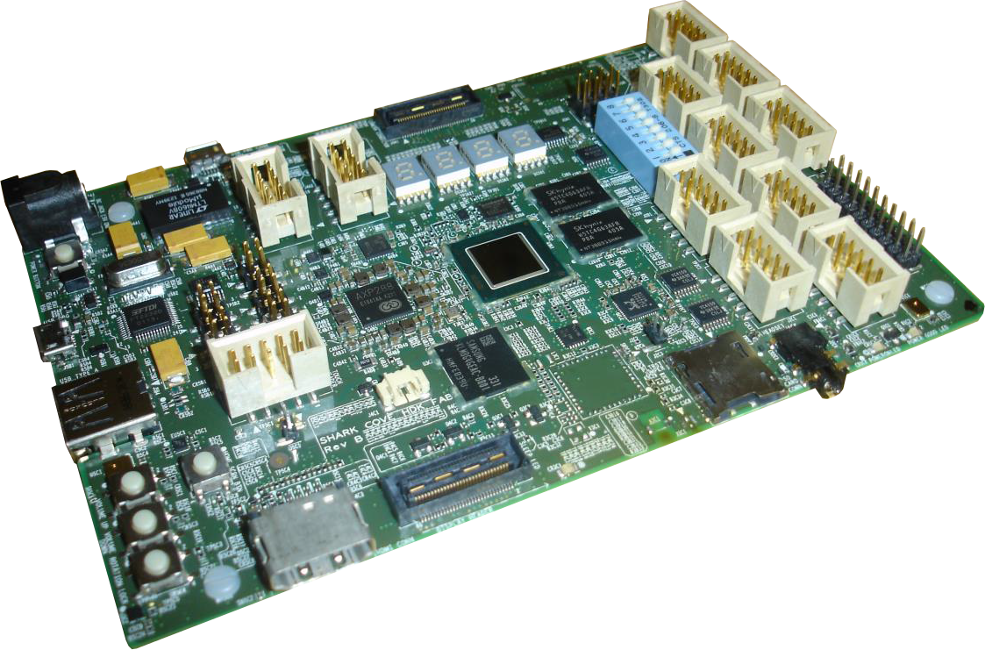


More than just galileo…
http://aka.ms/msmb
http://aka.ms/msscb

Slide 7
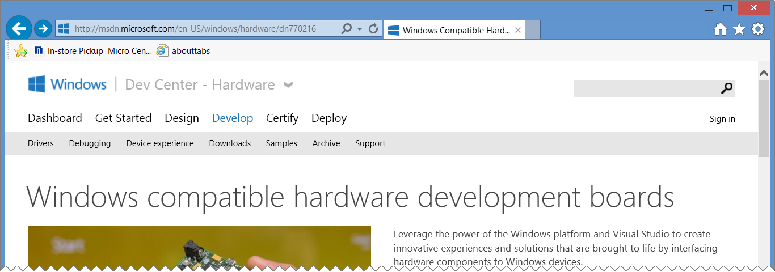
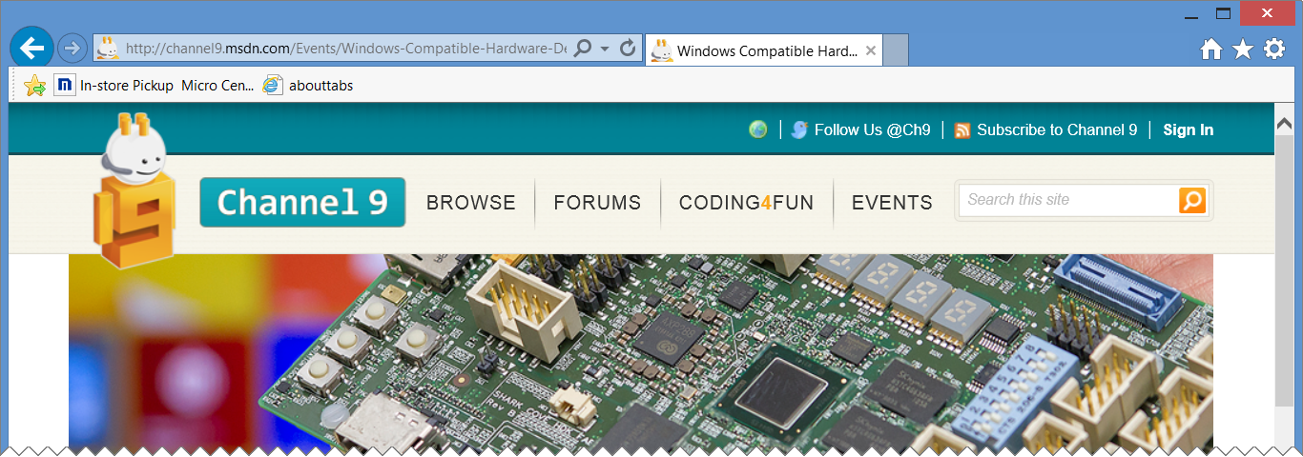
Windows compatible hardware development boards…
http://aka.ms/wchdb
http://aka.ms/wchdblive

Slide 8
Installing windows on galileo

Slide 9
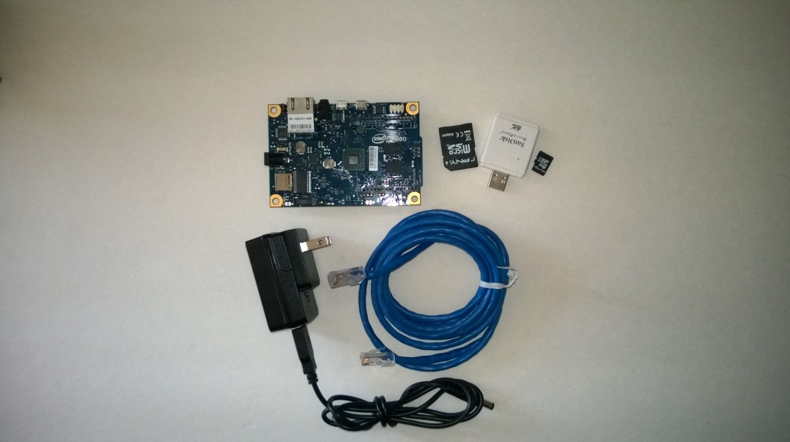
Here’s the hardware you need…

Slide 10
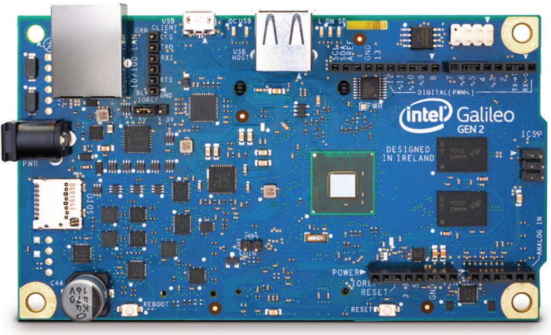
Gen 2 boards are NOT supported (yet)…
The embedded team hasn’t made any announcements or promises, but I hope to see support for the Gen 2 boards in the future.

Slide 11
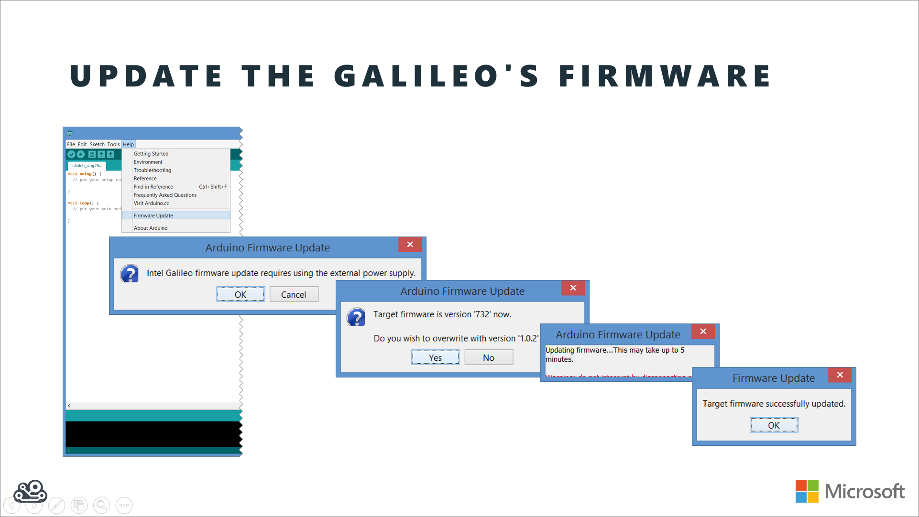
Ensure your firmware is updated
http://youtu.be/zUZmWe8nrc4

Slide 12
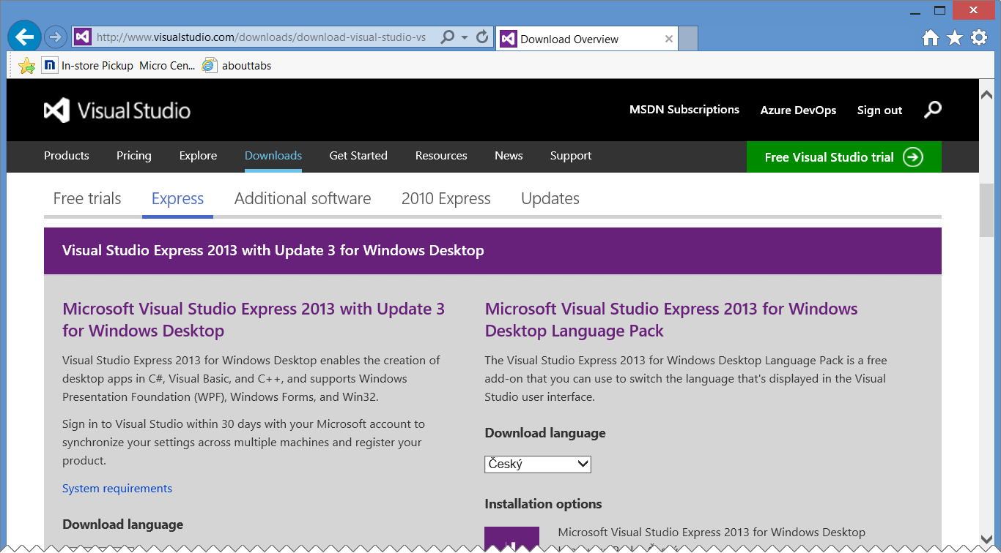
Install visual studio 2013…
Can use Visual Studio Express 2013 for Windows Desktop or a full version of Visual Studio http://visualstudio.com/downloads/

Slide 13
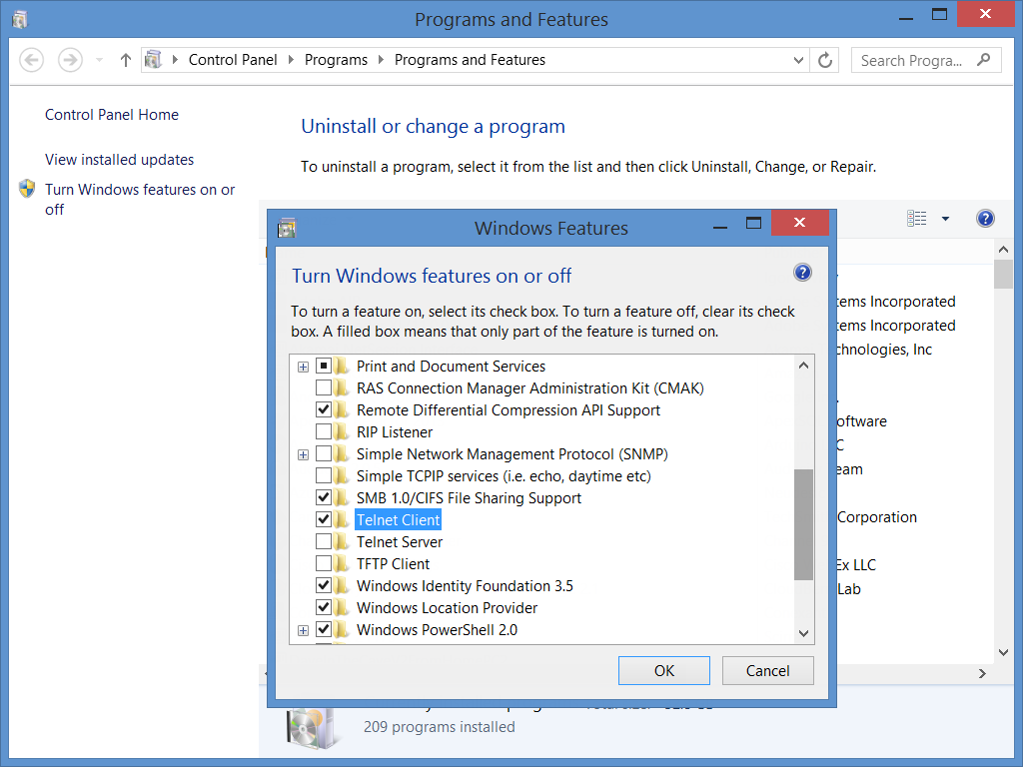
Install the telnet client…
You’ll use telnet to communicate with your Galileo. A telnet client ships with Windows, but isn’t installed by default. You‘ll need to add it manually…

Slide 14
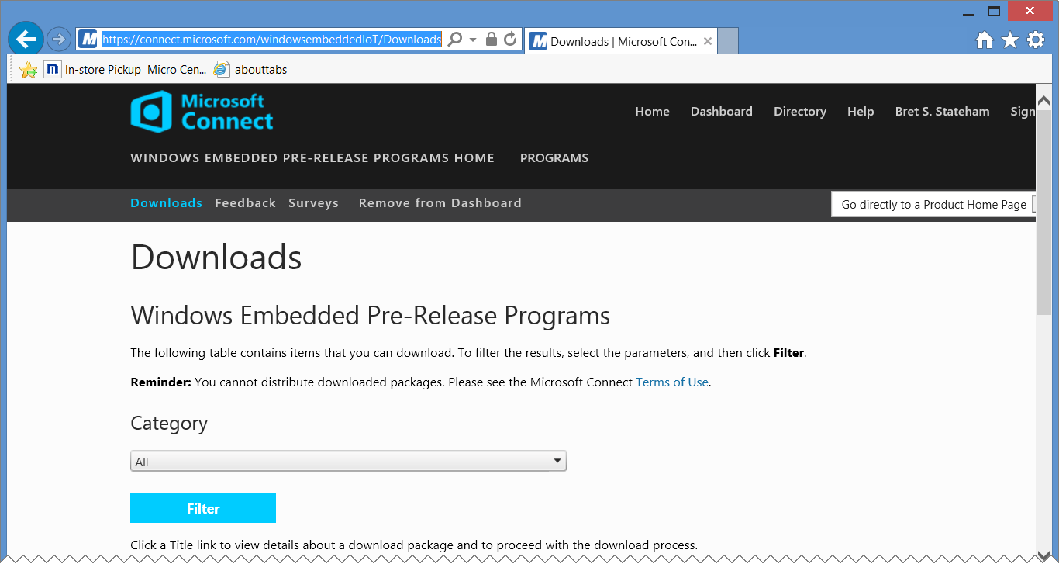
Download the windows image and tools…
Download | Description
Windows Developer Program for IoT – Microsoft Installer (MSI) | Installs Visual Studio project templates and GalileoWatcher.exe on your PC
Windows Developer Program For IoT – Windows Image (WIM) | The actual windows image that will be applied to the SD Card
Windows Developer Program For IoT – apply-bootmedia.cmd | The script to apply the WIM file (above) to the SD Card
https://connect.microsoft.com/windowsembeddedIoT/Downloads
You must have completed the registration process on windowsondevices.com before you can download

Slide 15
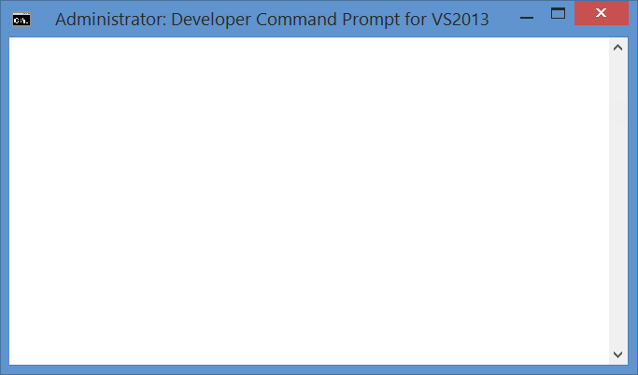
Install the windows image on your sd card…
C:\Galileo
C:\Galileo>apply-BootMedia.cmd -destination d:\ -image 9600.16384.x86fre.winblue
_rtm_iotbuild.140731-1000_galileo_v1.wim -hostname mygalileo -password admin
C:\Galileo>rem *****************************************************************
*********
C:\Galileo>rem ** Copyright (c) Microsoft Open Technologies, Inc. All rights re
served.
C:\Galileo>rem ** Licensed under the BSD 2-Clause License.
C:\Galileo>rem ** See License.txt in the project root for license information.
C:\Galileo>rem *****************************************************************
*********
**** Temporary changing time zone to 'Pacific Standard Time'
**** Fat32 is local time based, and the images are created in a pacific time zon
e. If there is a mismatch Windows will bug check after 5 minutes.
**** Set-up work folder: C:\Users\Bret\AppData\Local\Temp\apply-BootMedia-22943
**** Retrieveing C:\Galileo\9600.16384.x86fre.winblue_rtm_iotbuild.140731-1000_g
alileo_v1.wim
**** to C:\Users\Bret\AppData\Local\Temp\apply-BootMedia-22943
Deployment Image Servicing and Management tool
Version: 6.3.9600.17031
Mounting image
[==========================100.0%==========================]
The operation completed successfully.
**** Customizing image C:\Users\Bret\AppData\Local\Temp\apply-BootMedia-22943\96
00.16384.x86fre.winblue_rtm_iotbuild.140731-1000_galileo_v1.wim
**** mounted at C:\Users\Bret\AppData\Local\Temp\apply-BootMedia-22943\96
00.16384.x86fre.winblue_rtm_iotbuild.140731-1000_galileo_v1.wim.mount
Deployment Image Servicing and Management tool
Version: 6.3.9600.17031
Saving image
[==========================100.0%==========================]
Unmounting image
[==========================100.0%==========================]
The operation completed successfully.
**** Applying image C:\Users\Bret\AppData\Local\Temp\apply-BootMedia-22943\9600.
16384.x86fre.winblue_rtm_iotbuild.140731-1000_galileo_v1.wim
**** to d:\
Deployment Image Servicing and Management tool
Version: 6.3.9600.17031
Applying image
[==========================100.0%==========================]
The operation completed successfully.
**** Mounting d:\\Windows\System32\config\SYSTEM
**** to HKEY_USERS\Galileo-22943-SYSTEM
**** Setting hostname to mygalileo
**** Restoring time zone to 'Pacific Standard Time'
****
**** Successfully applied C:\Galileo\9600.16384.x86fre.winblue_rtm_iotbuild.14
0731-1000_galileo_v1.wim
**** to d:\
****
**** hostname: mygalileo
**** timezone: Pacific Standard Time
**** Username: Administrator
**** Password: admin
****
**** Done.
C:\Galileo>
apply-BootMedia.cmd
*.wim
D:\
efi
Remember these values. You’ll use them to connect to your Galileo
Program Files
Tools
Users
Windows

Slide 16
Creating a Windows Boot Image for Galileo

Slide 17
Boot galileo to windows…
You’ll receive a 169.254.*.* IPv4 address on both ends by default if you connect them directly (learn more)
SD IO Light Will Flicker
The entire boot process can take as long as two minutes

Slide 18
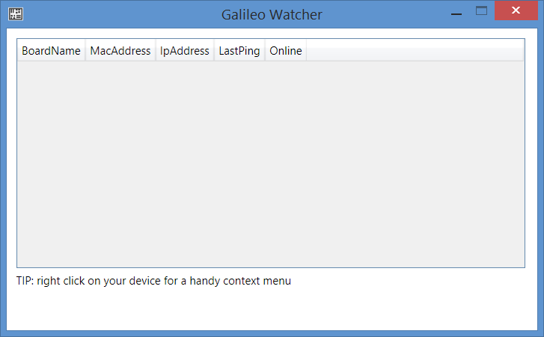
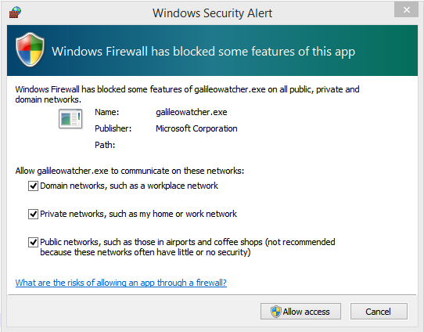
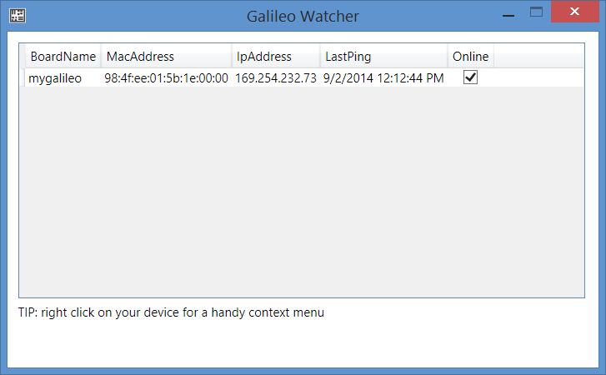
Run GalileoWatcher.exe on pC…
Installed as part of the: Windows Developer Program for IoT – Microsoft Installer (MSI)

Slide 19
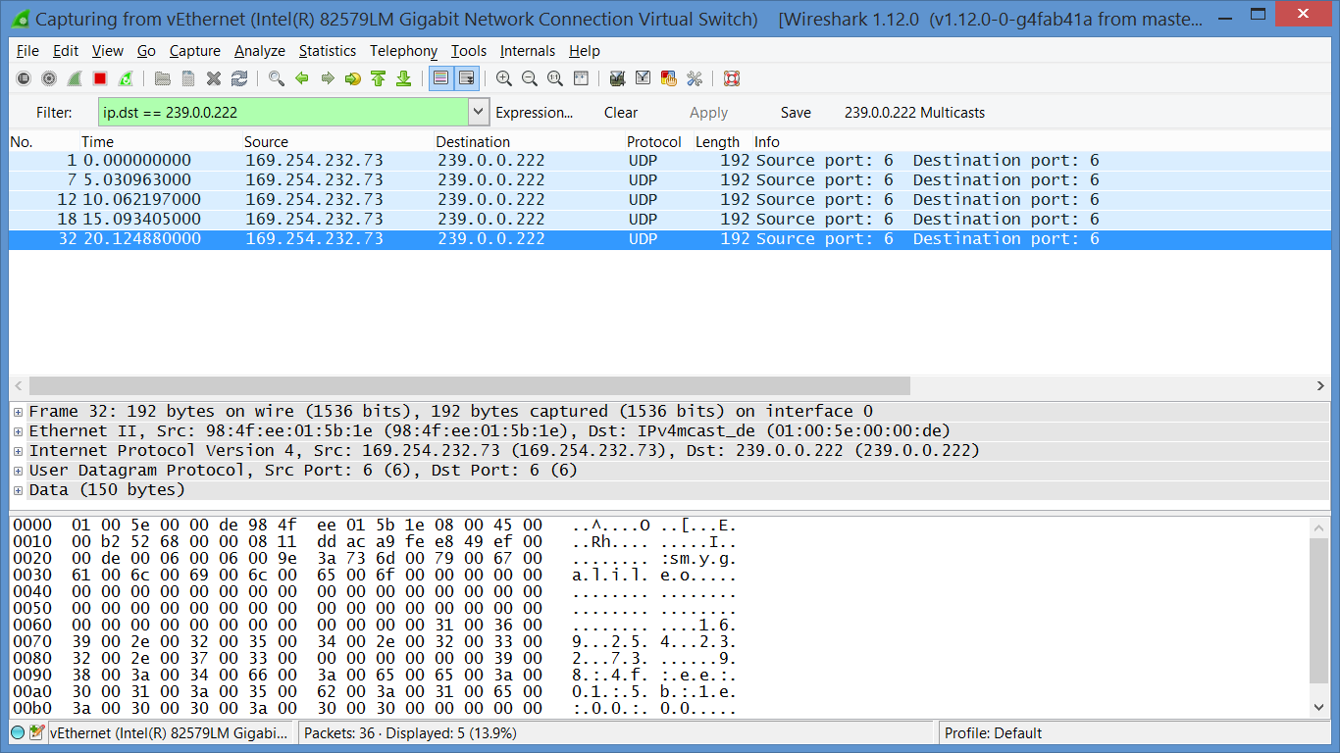
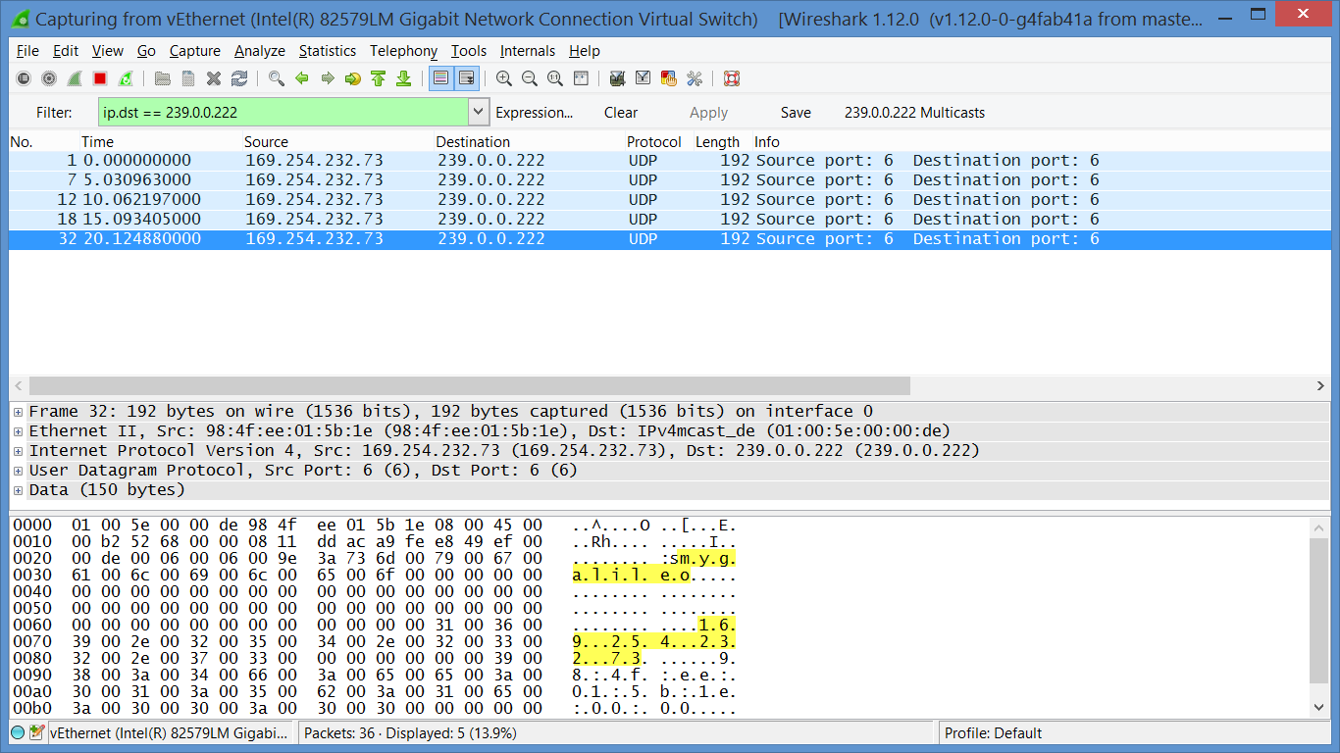
Galileo UDP multicasts…
hostname
IP Address
https://www.wireshark.org/

Slide 20
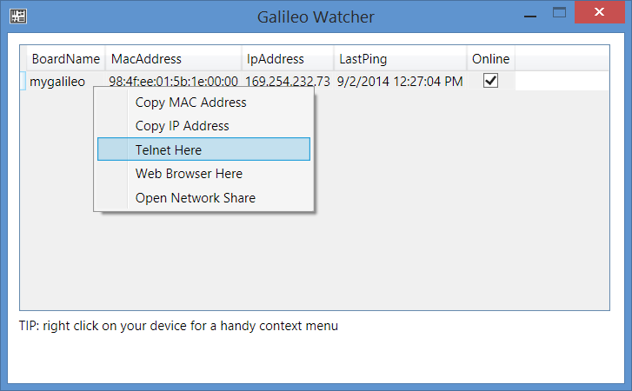
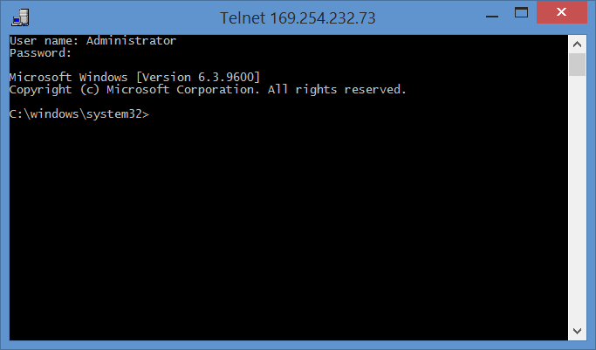
telnet into your galileo…
User name: Administrator Password: <Whatever you used in the apply-BootMedia.cmd execution> (admin)
Administrator
admin

Slide 21
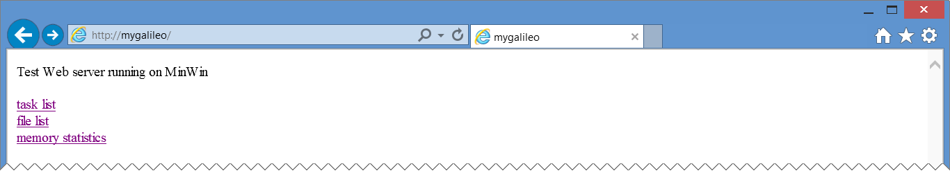
Browse to your galileo…
http://<your galileo hostname> or http://<your galileo ip addr>
“task list” shows a list of the running processes on your Galileo
“file list” hasn’t worked for me yet.
“memory statistics” shows your current memory status

Slide 22
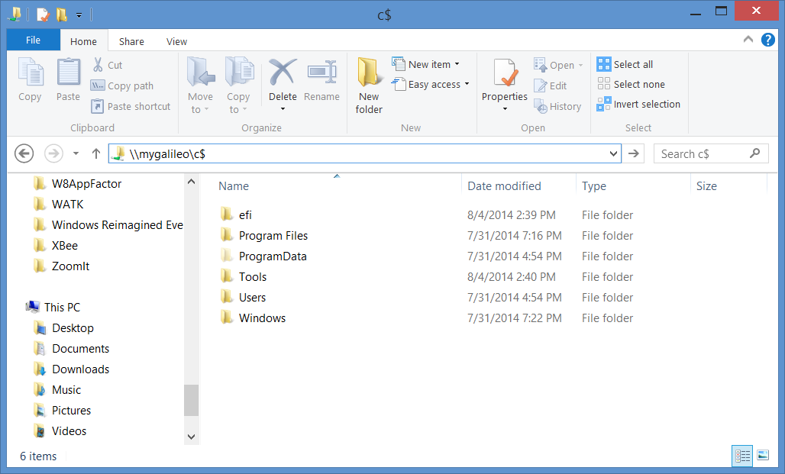
Galileo network share…

Slide 23
Booting to Windows on your Galileo

Slide 24
Running code in windows

Slide 25
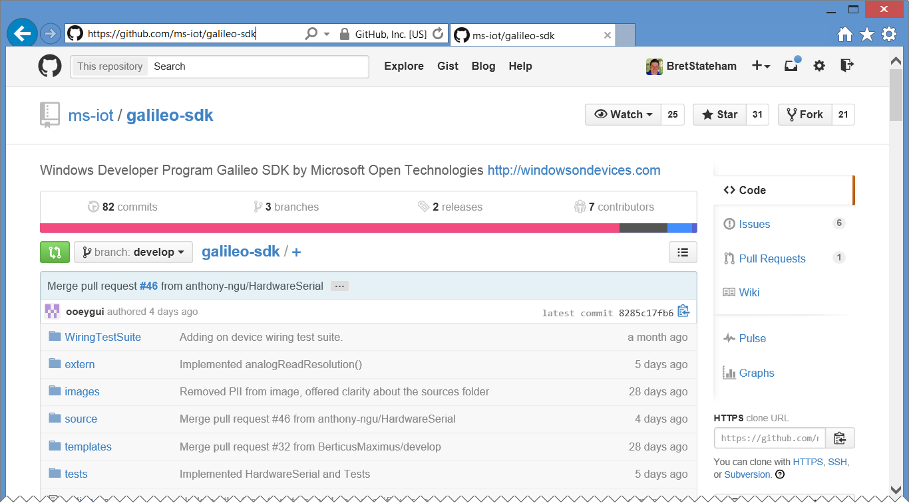
Galileo-sdk C++ wiring API implementation
https://github.com/ms-iot/galileo-sdk

Slide 26
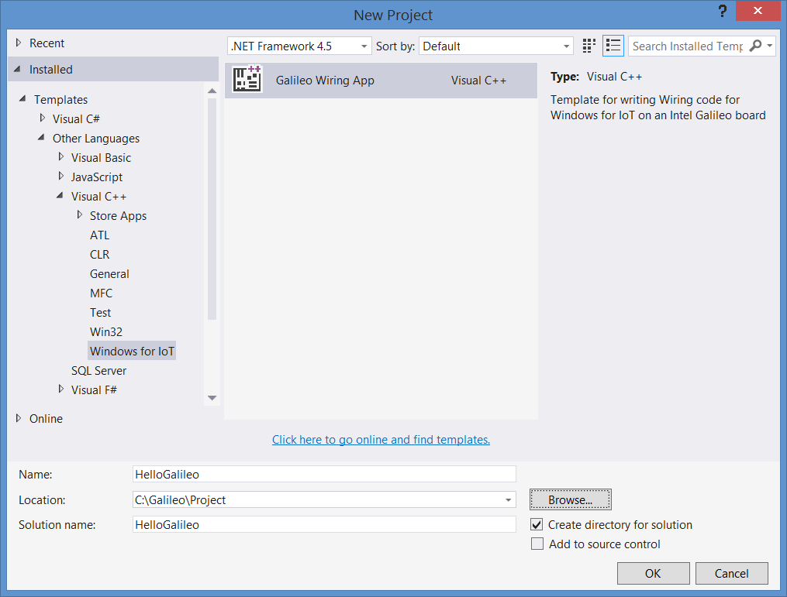
Galileo wiring app C++ project template
Installed as part of the: Windows Developer Program for IoT – Microsoft Installer (MSI)
It is basically a C++ console app that has references to the Galileo-SDK (Wiring API) to allow it to talk to the Arduino side of things.

Slide 27
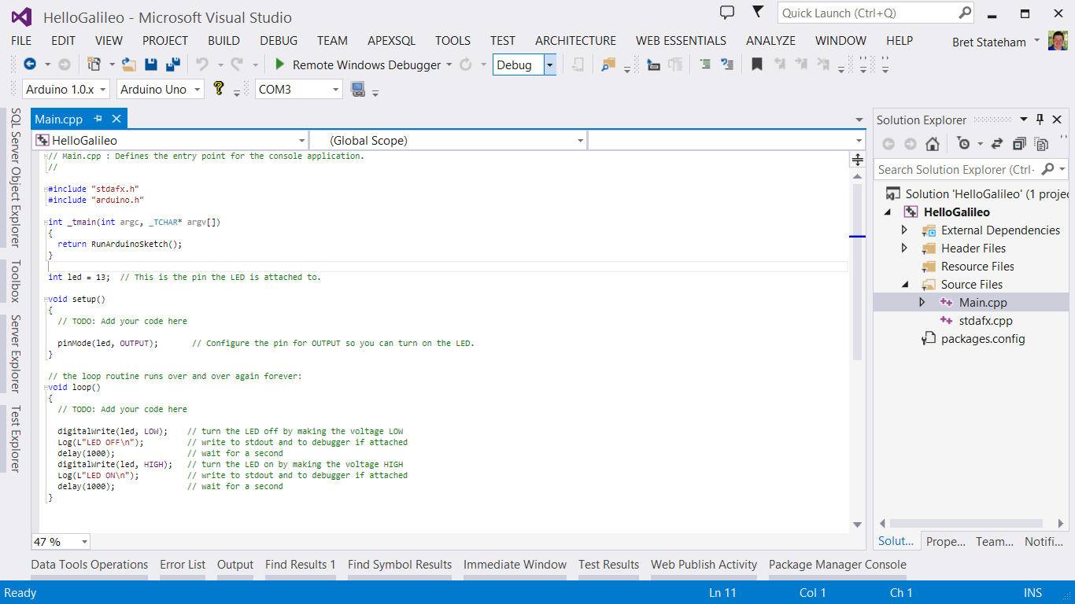
Main.cpp

Slide 28
Default sketch
// Main.cpp : Defines the entry point for the console application.
//
#include "stdafx.h"
#include "arduino.h"
int _tmain(int argc, _TCHAR* argv[])
{
return RunArduinoSketch();
}
int led = 13; // This is the pin the LED is attached to.
void setup()
{
// TODO: Add your code here
pinMode(led, OUTPUT); // Configure the pin for OUTPUT so you can turn on the LED.
}
// the loop routine runs over and over again forever:
void loop()
{
// TODO: Add your code here
digitalWrite(led, LOW); // turn the LED off by making the voltage LOW
Log(L"LED OFF\n"); // write to stdout and to debugger if attached
delay(1000); // wait for a second
digitalWrite(led, HIGH); // turn the LED on by making the voltage HIGH
Log(L"LED ON\n"); // write to stdout and to debugger if attached
delay(1000); // wait for a second
}
The Log() method writes output to stdout and to the debugger if it is attached

Slide 29
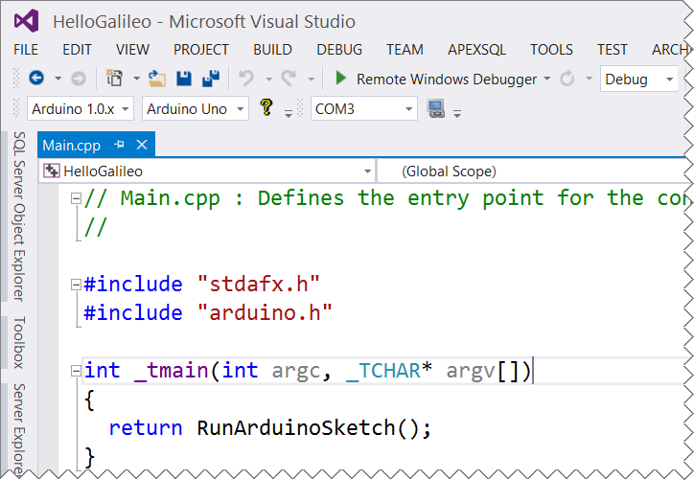
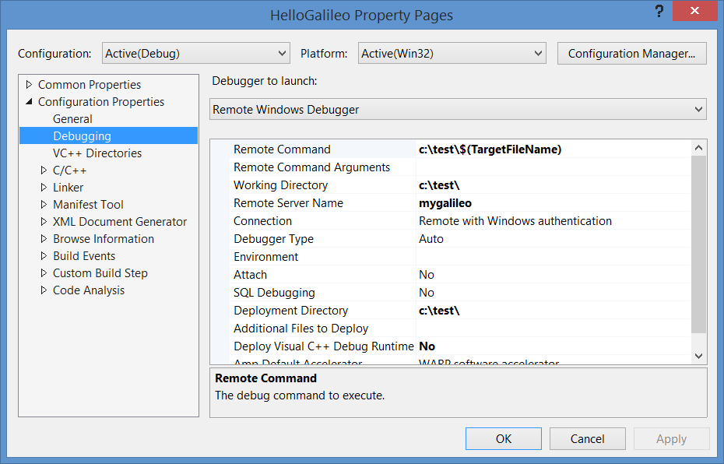
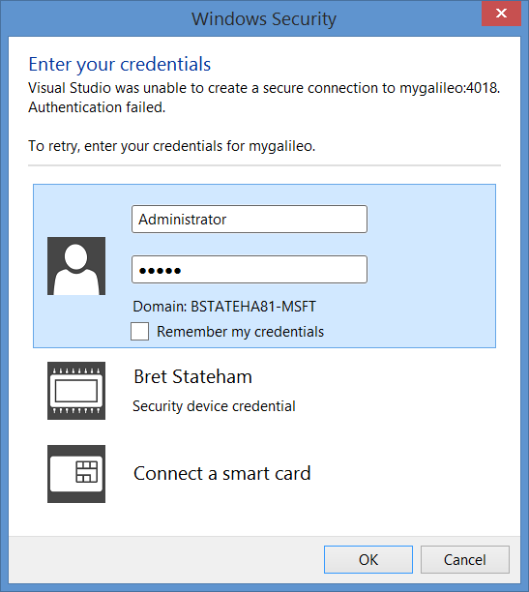
Remote debugging on your galileo…

Slide 30
Writing code on your Galileo

Slide 31
Next steps

Slide 32
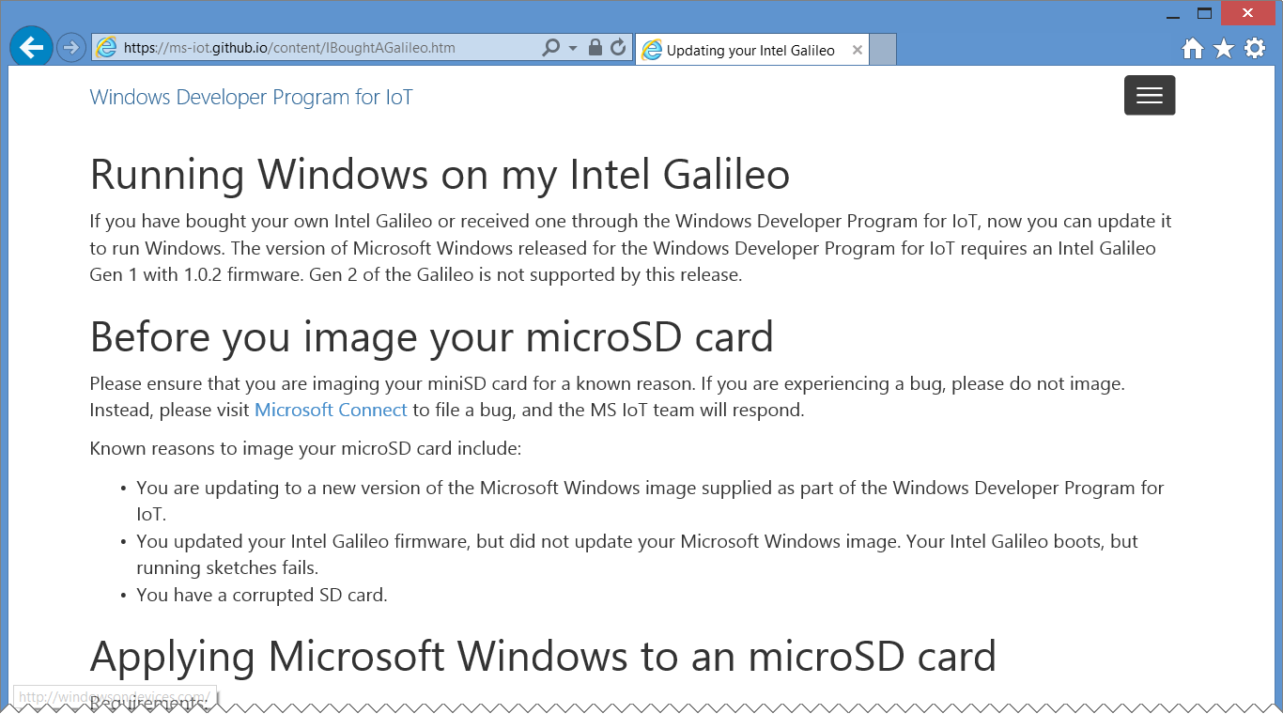
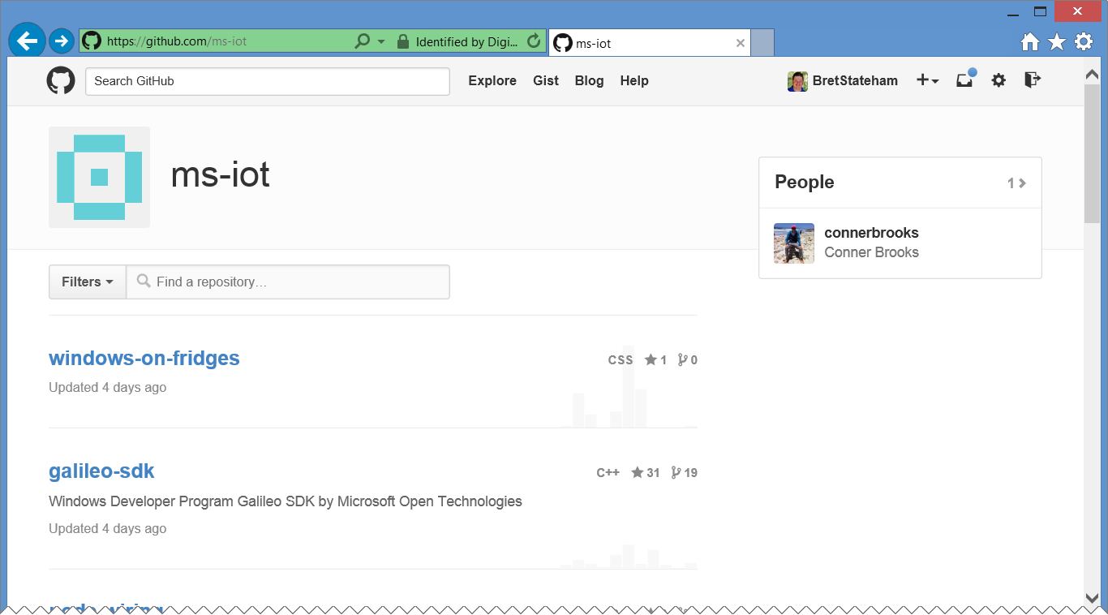
Resources and code on github…
http://ms-iot.github.io/content/IBoughtAGalileo.htm
https://github.com/ms-iot

Slide 33
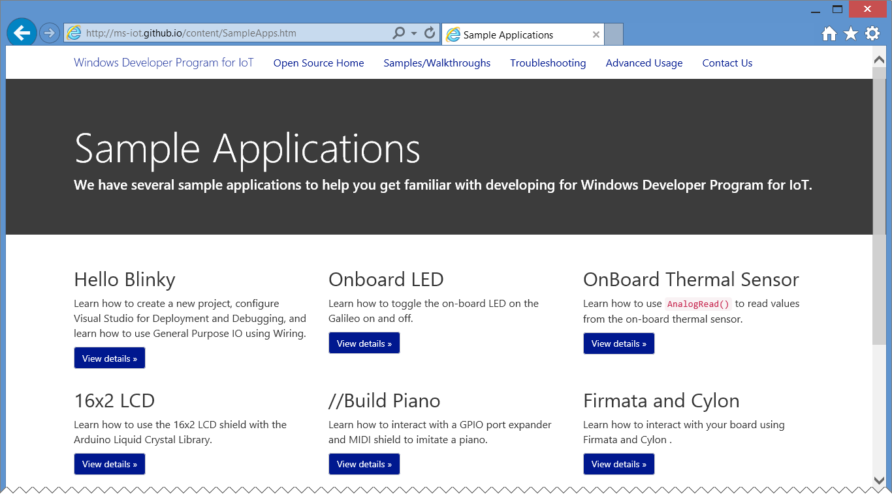
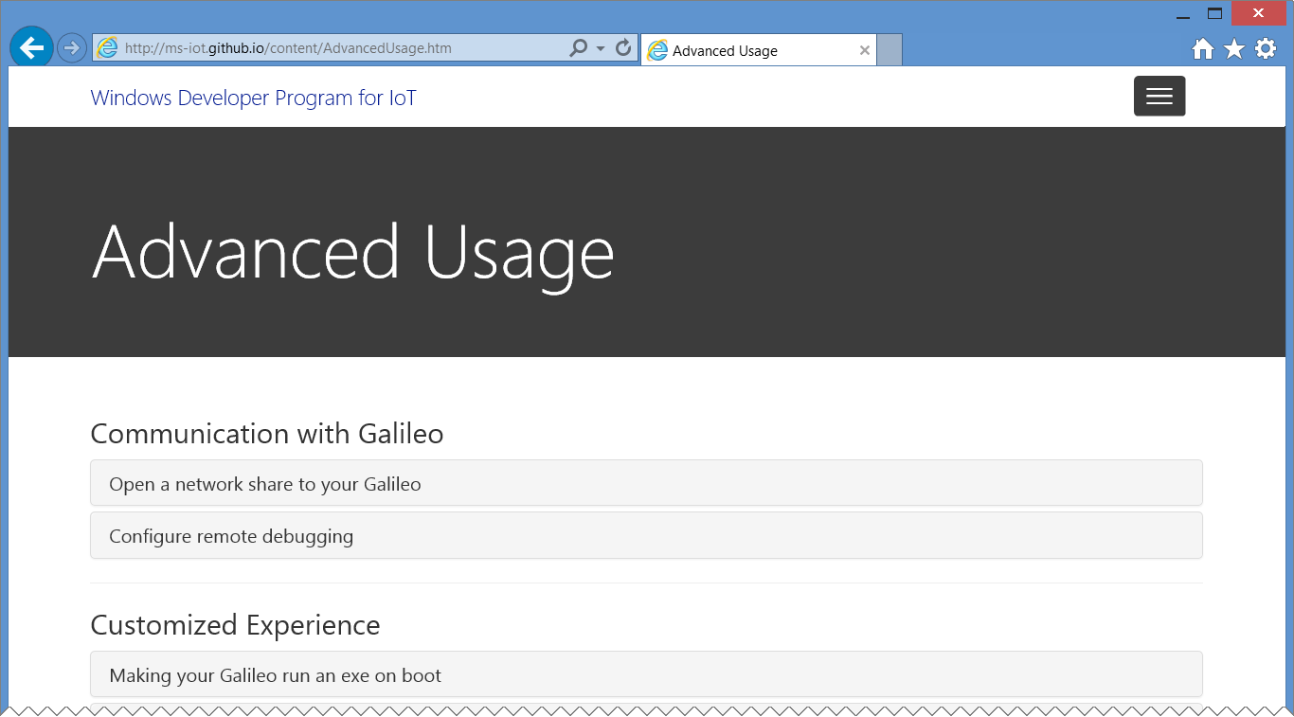
Explore other samples…
The //build/ piano demo
GPIO Direct
16X2 LCD
Communication and control with Firmata and Cylon
More to come!
http://ms-iot.github.io/content/SampleApps.htm

Slide 34
Advanced Usage…
Connecting to your Galileo
Configuring Remote Debugging
Running a sketch on boot
Troubleshooting, etc.
http://ms-iot.github.io/content/AdvancedUsage.htm

Slide 35
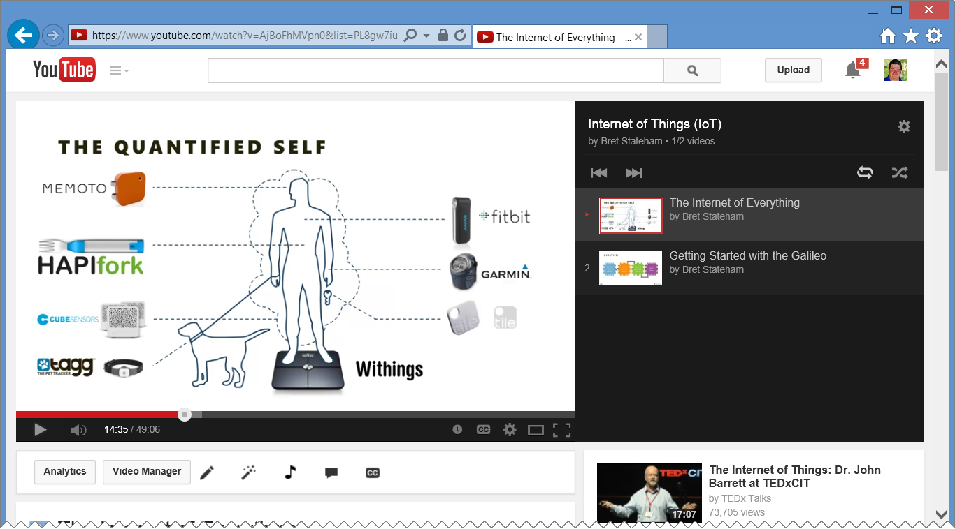
Watch other videos in the series…
http://aka.ms/iotvids

Slide 36
Get the files…
The source files of the slides and demos for my entire IoT series here: http://aka.ms/IoTSource
Or download a .zip with the latest files: http://aka.ms/IoTZip
Finally, watch my IoT videos here: http://aka.ms/IoTVids

Slide 37
REVIEW
Windows Developer Program for IoT
Installing Windows on Galileo
Running Code
In Windows
Next Steps

Slide 38
IoT Logo

Slide 39
arduino

Slide 40
GALILEO BOARD

Slide 41
LEDs

Slide 42
Resistors
220Ω
1st Digit
2nd Digit
Multiplier
Tolerance
Color | Name | 1st Digit | 2nd Digit | Multiplier | Tolerance
 | Black | 0 | 0 | X1
 | Brown | 1 | 1 | X10 | 1%
 | Red | 2 | 2 | X100
 | Orange | 3 | 3 | X1,000
 | Yellow | 4 | 4 | X10,000
 | Green | 5 | 5 | X100,000
 | Blue | 6 | 6 | X1,000,000
 | Violet | 7 | 7
 | Grey | 8 | 8
 | White | 9 | 9
 | Gold |  |  | X0.1 | 5%
 | Silver |  |  | X0.01 | 10%
330Ω
10KΩ

Slide 43
USB and power cables

